Slide 1
Single Page Applications and Routing
Getting started with SPAs and routing
Parameterized routes
Nested routes
Loading data for a route

Slide 2
Section 1: Getting Started with SPAs and Routing
Overview
Dependencies for React Router
Creating a browser router
Defining a common layout for all pages
Simple example routes

Slide 3
Overview
React has excellent support for implementing SPAs
Define an App component that always remains resident
Define multiple sub-components, which can be swapped in and out of the App component
Each sub-component maps to a logical URL
This is called routing
To display a different sub-component in the browser, simply navigate to the URL for that sub-component

Slide 4
Dependencies for React Router
Add these dependencies in package.json:
"dependencies": {
"react-router-dom": "^6.3.0",
…
},
"devDependencies": {
"@types/react-router-dom": "^5.3.3",
…
}
React Router
React Router TypeScript declarations
package.json

Slide 5
Creating a Browser Router
You define routes via createBrowserRouter()
Enables you to specify routes up-front in your app
Use the router in your App component as follows:
import { createBrowserRouter, RouterProvider } from 'react-router-dom'
…
const router = createBrowserRouter([
{ path: '/somePath1', element: <SomeComponent1 /> },
{ path: '/somePath2', element: <SomeComponent2 /> },
…
]}
export default function App() {
return <RouterProvider router={router} />
}
App.tsx

Slide 6
Defining a Common Layout for all Pages
You can define a common layout for all pages:
import { Outlet } from 'react-router-dom'
…
function AppLayout() {
return (
<>
<MyMenu /> { /* Always display my common menu here (for example) */ }
<Outlet /> { /* Display the component for the current route here */ }
</>
)
}
const router = createBrowserRouter([
{
element: <AppLayout />,
children: [
{ path: '/somePath1', element: <SomeComponent1 /> },
{ path: '/somePath2', element: <SomeComponent2 /> },
…
]
}
])
App.tsx

Slide 7
Simple Example Routes
Here are some simple example routes to get us started:
import Home from './Home'
import About from './About'
import Contact from './Contact'
import PageNotFound from './PageNotFound'
…
const router = createBrowserRouter([
{
element: <AppLayout />,
children: [
{ path: '/', element: <Home /> },
{ path: '/about', element: <About /> },
{ path: '/contact', element: <Contact /> },
{ path: '*', element: <PageNotFound /> },
…
]
}
])
App.tsx

Slide 8
Section 2: Parameterized Routes
Overview
Understanding the data model
Defining parameterized routes
Rendering parameterized links
Obtaining path parameters
Programmatic navigation

Slide 9
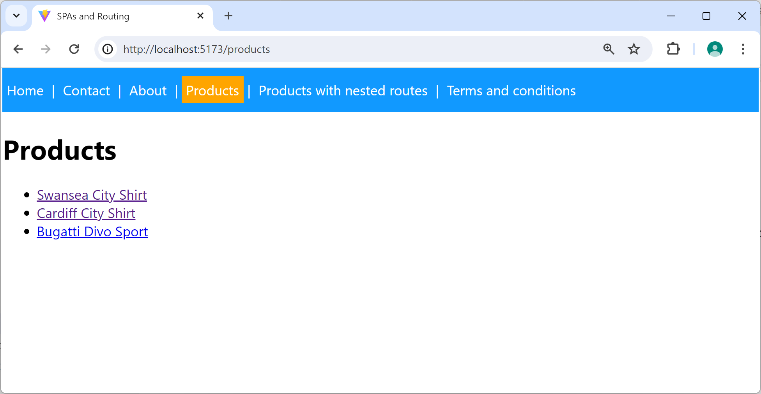
Overview
React router lets you define parameterized routes
E.g., /product/:id
The demo app illustrates parameterized routes
/product/1
/product/2
/product/3
9

Slide 10
Understanding the Data Model
To understand the demo, the first step is to consider the data model
See Catalog.ts, which defines 2 simple classes:
ProductItem - Represents a simple product item
Catalog - Contains hard-coded product items
10

Slide 11
Defining Parameterized Routes
Here are the relevant routes:
/products - Display links for all product items
/product/:id - Display a product item with specified id
{ path: 'products', element: <Products /> },
{ path: 'product/:id', element: <Product /> },
App.tsx
11

Slide 12
Rendering Parameterized Links
Products.tsx renders parameterized links like so:
export default function Products() {
const products = Catalog.getAllProductItems()
return (
<>
<h1>Products</h1>
<ul>
{
products.map((p, i) =>
<li key={i}>
<Link to={`/product/${p.id}`}>{p.description}</Link>
</li>
)
}
</ul>
</>
)
}
Products.tsx
12

Slide 13
Obtaining Path Parameters
ProductV1.tsx obtains path parameter(s) like so:
import { useParams } from 'react-router-dom'
…
export default function Product() {
const { id } : any = useParams()
const prod = Catalog.getProductItemById(id)
if (!prod) {
…
}
else {
return (
<>
<h1>Product details</h1>
<div>Description: {prod.description}</div>
<div>Price: {prod.price}</div>
<div>Likes: {prod.likes}</div>
<div>Most recent like: {prod.mostRecentLike}</div>
</>
)
}
}
ProductV1.tsx
13

Slide 14
Programmatic Navigation
We've seen how to navigate to a route via a <Link>
You can also navigate to a route programmatically
For an example, see ProductV2.tsx
<Link to='somePath'>Click me</Link>
import { useNavigate } from 'react-router-dom'
…
function SomeComponent() {
const navigate = useNavigate()
navigate(somePath)
…
}
14

Slide 15
Section 3: Nested Routes
Overview
Implementing the outer route
Implementing an index route
Implementing a nested route
Implementing another nested route

Slide 16
Overview
React router lets you define nested routes
The user can navigate to the following routes:
/products-with-nested-routes
/products-with-nested-routes/1 (etc.)
/products-with-nested-routes/summary
{
path: '/products-with-nested-routes', element: <ProductsWithNestedRoutes />,
children: [
{ index: true, element: <ProductUnselected /> },
{ path: ':id', element: <Product /> },
{ path: 'summary', element: <ProductSummary /> }
]
},
App.tsx
16

Slide 17
Implementing the Outer Route
Let's consider the outer route:
When we go to /products-with-nested-routes
ProductsWithNestedRoutes component is rendered
Contains an <Outlet/>, to house a nested component
{
path: '/products-with-nested-routes', element: <ProductsWithNestedRoutes />,
children: [
{ index: true, element: <ProductUnselected /> },
{ path: ':id', element: <Product /> },
{ path: 'summary', element: <ProductSummary /> }
]
},
App.tsx
17

Slide 18
Implementing an Index Route
We've defined an index route as follows:
Indicates the default component to render in <Outlet/> if the user navigates just to the parent route
ProductUnselected component is rendered
{
path: '/products-with-nested-routes', element: <ProductsWithNestedRoutes />,
children: [
{ index: true, element: <ProductUnselected /> },
{ path: ':id', element: <Product /> },
{ path: 'summary', element: <ProductSummary /> }
]
},
App.tsx
18

Slide 19
Implementing a Nested Route
We've defined a nested route to display one product:
Go to /products-with-nested-routes/1
ProductsWithNestedRoutes component is rendered
In its <Outlet/>, Product component is rendered
{
path: '/products-with-nested-routes', element: <ProductsWithNestedRoutes />,
children: [
{ index: true, element: <ProductUnselected /> },
{ path: ':id', element: <Product /> },
{ path: 'summary', element: <ProductSummary /> }
]
},
App.tsx
19

Slide 20
Implementing another Nested Route
We've defined another nested route as follows:
Go to /products-with-nested-routes/summary
ProductsWithNestedRoutes component is rendered
In its <Outlet/>, ProductSummary component is rendered
{
path: '/products-with-nested-routes', element: <ProductsWithNestedRoutes />,
children: [
{ index: true, element: <ProductUnselected /> },
{ path: ':id', element: <Product /> },
{ path: 'summary', element: <ProductSummary /> }
]
},
App.tsx
20

Slide 21
Section 4: Loading Data for a Route
Defining a data loader function for a route
Accessing loader data in a component
Example

Slide 22
Defining a Data Loader Function for a Route
In this chapter we've shown how to define routes via the createBrowserRouter() function
You can also specify a data loader function for a route
Invoked asynchronously when user navigates to the route
Returns data that the component can utilize
const router = createBrowserRouter([
{ path: '/somePath1', element: <SomeComponent1 /> },
{ path: '/somePath2', element: <SomeComponent2 /> },
…
const router = createBrowserRouter([
{ path: '/somePath1', element: <SomeComponent1 />, loader: someLoaderFunc1 },
{ path: '/somePath2', element: <SomeComponent2 />, loader: someLoaderFunc2 },
…
22

Slide 23
Accessing Loader Data in a Component
A component can access the loader data via the useLoaderData() hook
import { useLoaderData } from 'react-router-dom'
…
function SomeComponent() {
const data: any = useLoaderData()
…
}
23

Slide 24
Example
For an example of loading data and accessing it in a component, see the following files:
App.tsx
See the route /ts-and-cs/:id
TsAndCs.tsx
See getDataForRegion(), which loads data
See TsAndCsForRegion(), which accesses the data
24

Slide 25
Summary
Getting started with SPAs and routing
Parameterized routes
Nested routes
Loading data for a route

